Slide 1
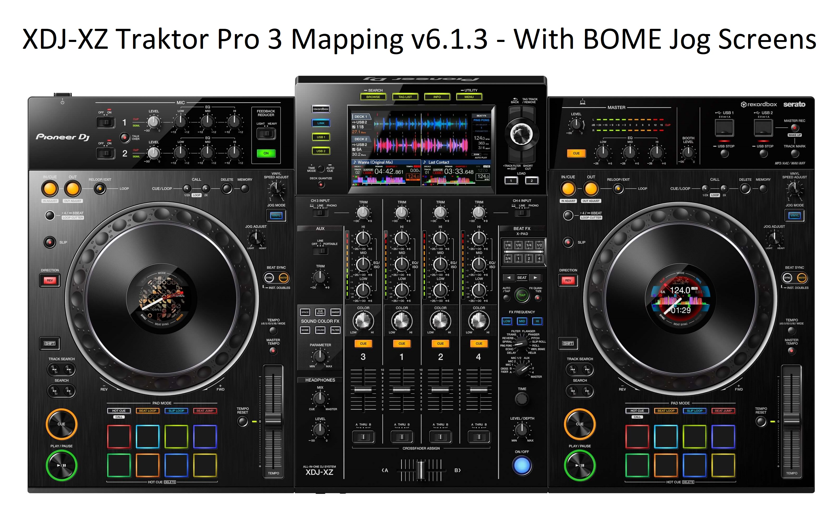
XDJ-XZ: Loops
Loop In
Loop Out
No action
4-beat Loop / Loop Disable
Loop 1/2X
+
Beatjump/Loop move
+
Deck Zoom

